Slide 1
Course Outcomes
CO1: Characterize a system mathematically and find its steady state behaviour
CO2: Analyze stability of a system using different tests
CO3: Design various controllers
CO4: Solve linear, non-linear and optimal complex control problems
CO5: Designing state model for a given system of equations

Slide 2
Disclaimer
The contents used in this presentation are taken from the text books mentioned in the references. I do not hold any copyrights for the contents. It has been prepared to use in the class lectures, not for commercial purpose.

Slide 3
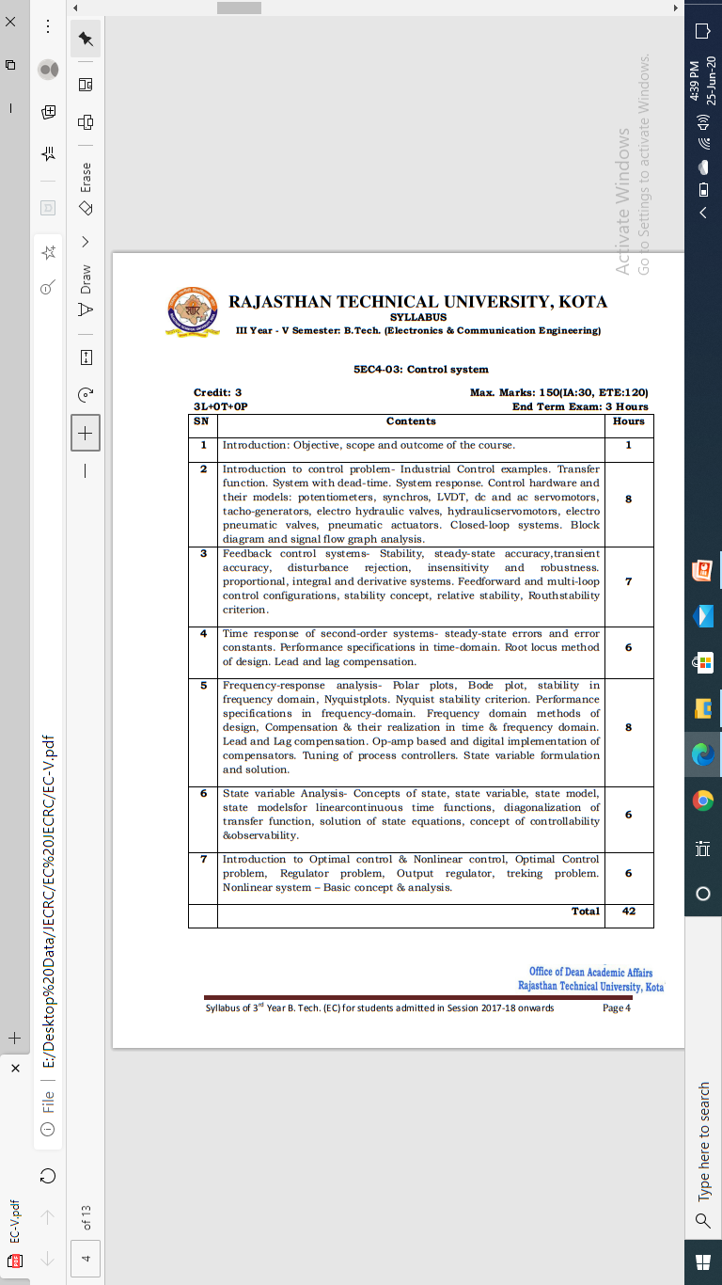
Syllabus

Slide 4
UNIT-II

Slide 5
OVERVIEW OF UNIT-II
Effect of Feedback on Control System
  Parameter Variation (Robustness)
  Time Constant (Speed of Response)
  Sensitivity
  Disturbance Rejection
Stability
Relative Stability
Routh Stability Criterion
Examples

Slide 6
Stability
Appreciate the importance of stability
Analyze different types of stability
Apply Routh’s stability criterion for stability analysis and solve the numerical.

Slide 7
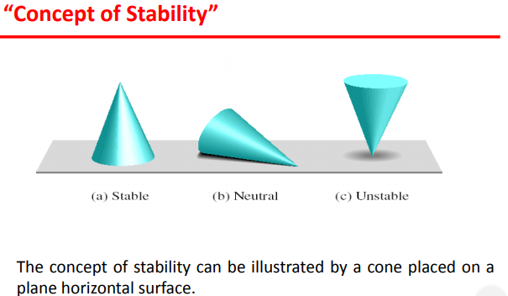

Slide 8
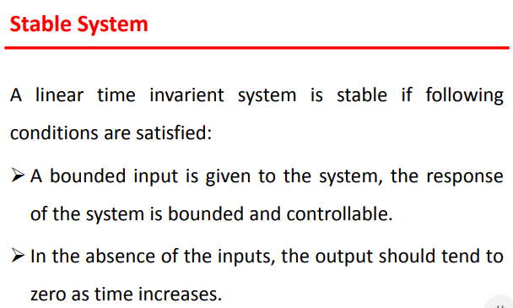

Slide 9
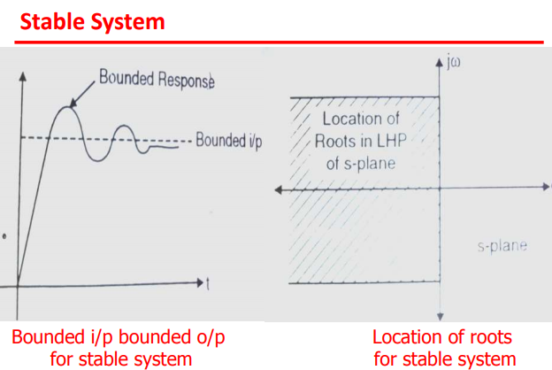

Slide 10
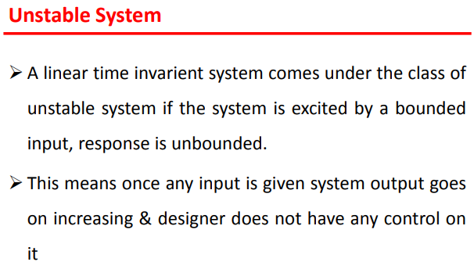

Slide 11
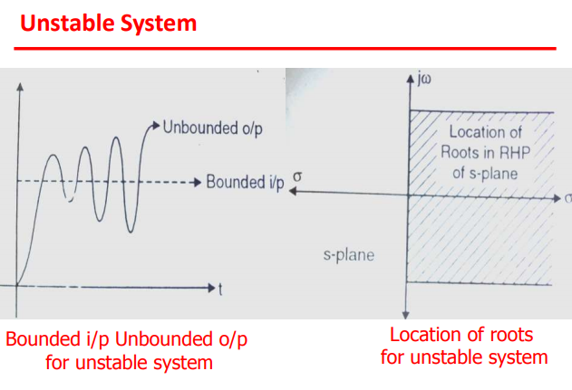

Slide 12
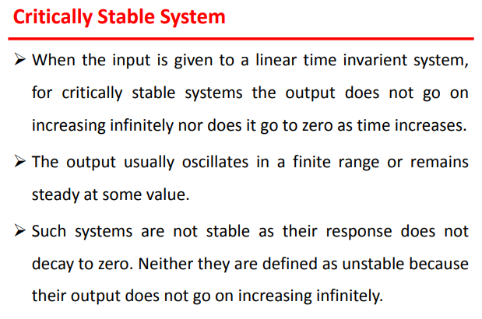

Slide 13
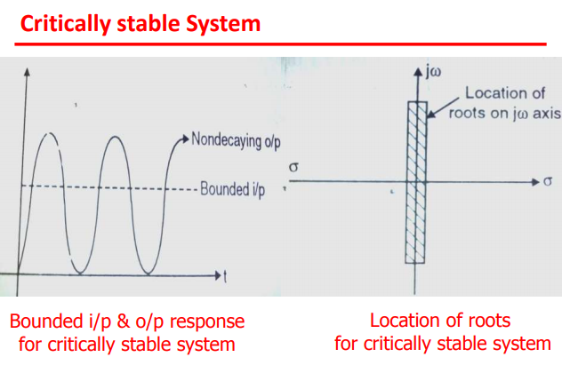

Slide 14
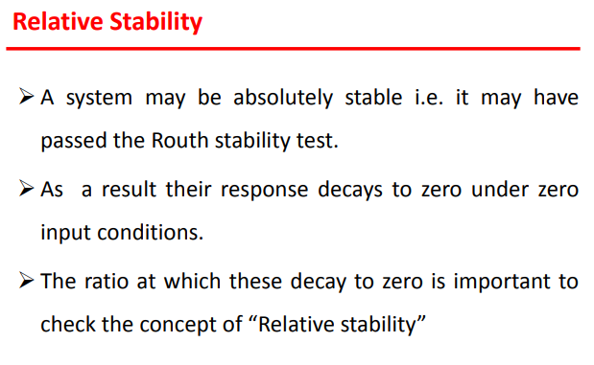

Slide 15
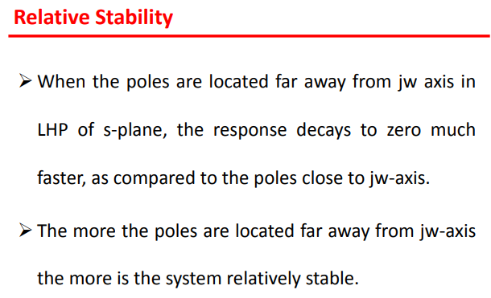

Slide 16
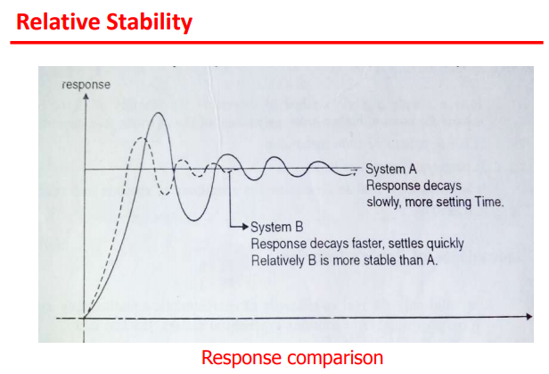

Slide 17
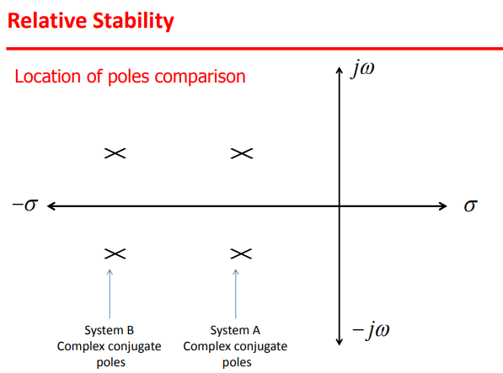

Slide 18
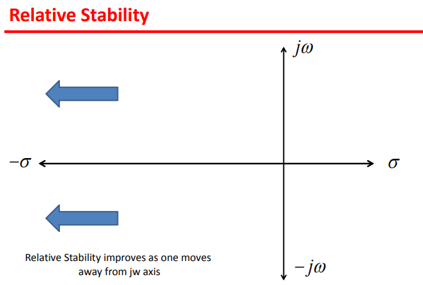

Slide 19
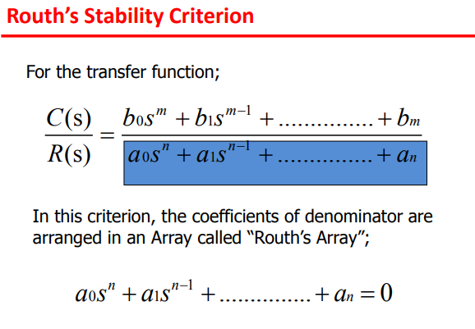

Slide 20
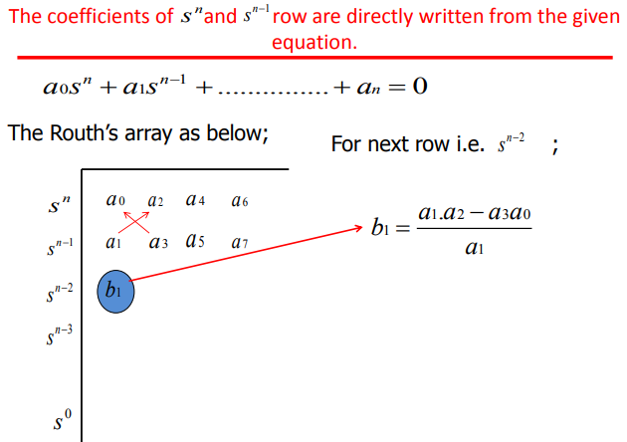

Slide 21
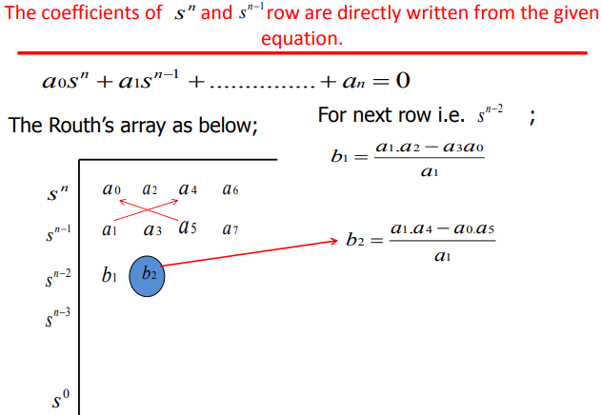

Slide 22
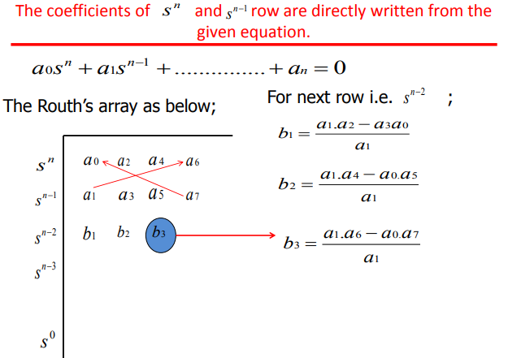

Slide 23
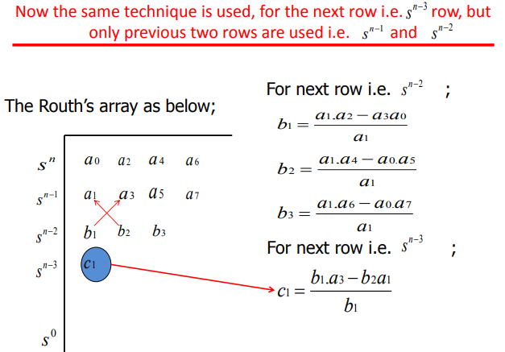

Slide 24
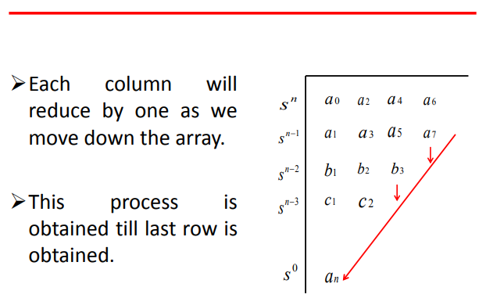

Slide 25
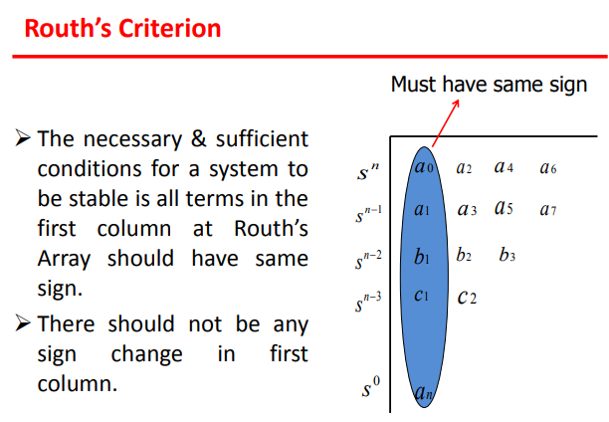

Slide 26
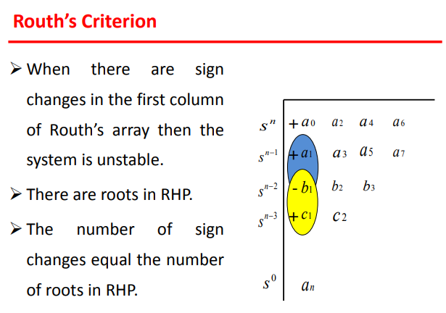

Slide 27
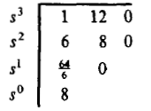
Example-1: Find the stability of the continues system having the characteristic equation of
The Routh table of the given system is computed and shown is the table below;
Since there is no changes of the sign in the first column of the Routh table, it means that all the roots of the characteristic equation have negative real parts and hence this system is stable.

Slide 28
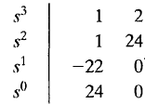
Example-2: Find the stability of the continues system having the characteristic polynomial of a third order system is given below
The Routh array is
Because TWO changes in sign appear in the first column, we find that two roots of the characteristic equation lie in the right hand side of the s-plane. Hence the system is unstable.

Slide 29
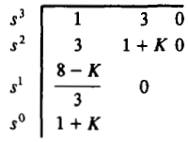
Example-3: Determine a rang of values of a system parameter K for which the system is stable.
The Routh table of the given system is computed and shown is the table below;
For system stability, it is necessary that the conditions 8 – k >0, and 1 + k > 0, must be satisfied. Hence the rang of values of a system parameter k must be lies between -1 and 8 (i.e., -1 < k < 8).

Slide 30


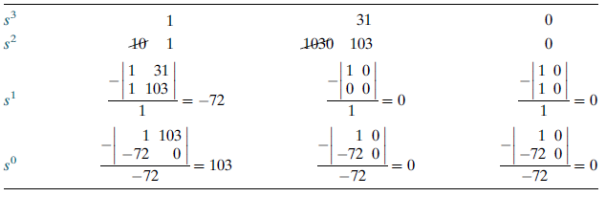
Example-4: Find the stability of the system shown below using Routh criterion.
The close loop transfer function is shown in the figure
The Routh table of the system is shown in the table
Because TWO changes in sign appear in the first column, we find that two roots of the characteristic equation lie in the right hand side of the s-plane. Hence the system is unstable.

Slide 31
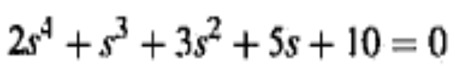
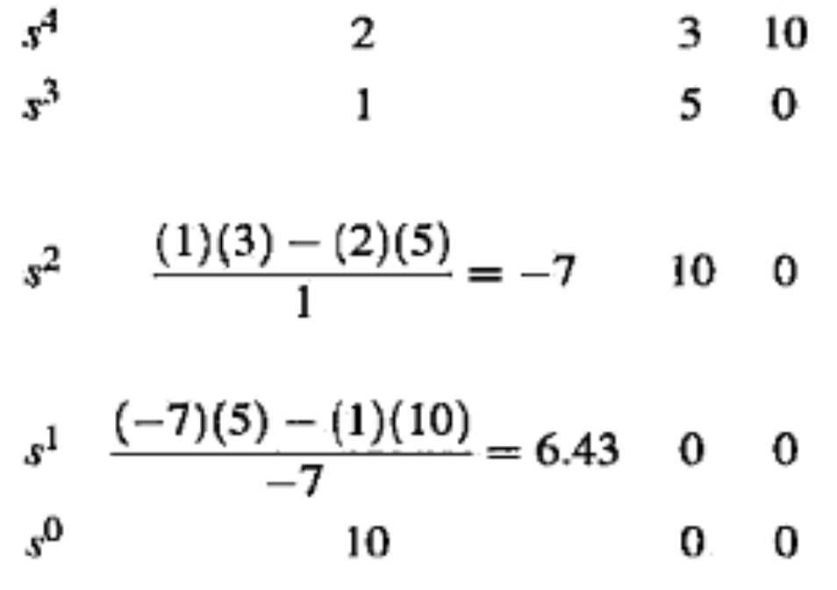
The Routh table of the system is
System is unstable because there are two sign changes in the first column of the Routh’s table. Hence the equation has two roots on the right half of the s-plane.

Slide 32
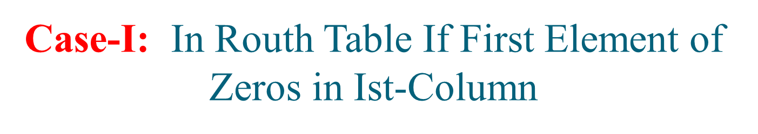
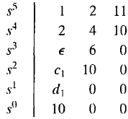

Example-6: Determine the stability of the system having a characteristic equation given below;
The Routh array is shown in the table;
Where
There are TWO sign changes due to the large negative number in the first column,
Therefore the system is unstable, and two roots of the equation lie in the right half of the s-plane.

Slide 33
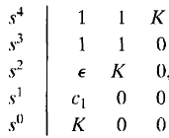

The Routh array of the above characteristic equation is shown below;
Where
Therefore, for any value of K greater than zero, the system is unstable.
Also, because the last term in the first column is equal to K, a negative value of K will result in an unstable system.
Consequently, the system is unstable for all values of gain K.

Slide 34
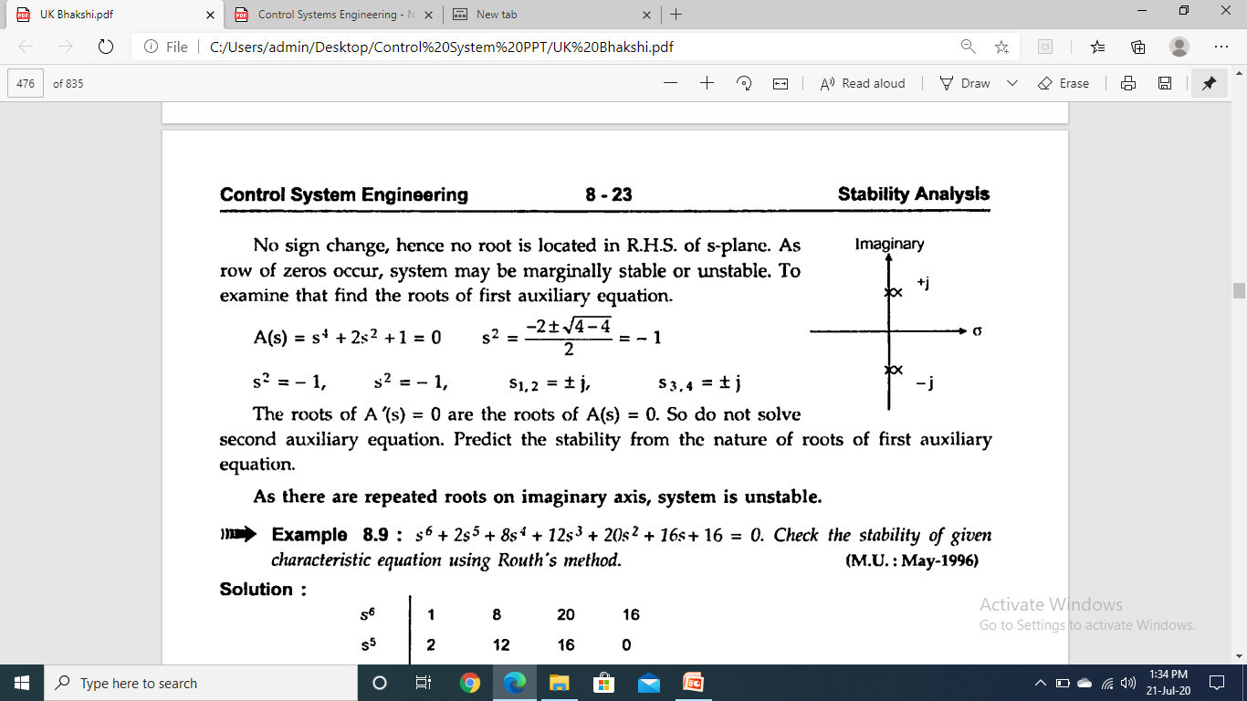
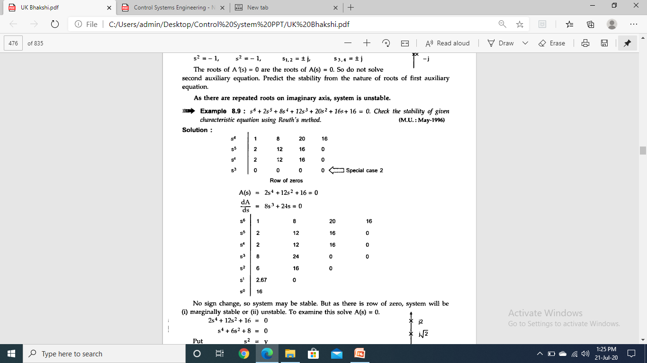
Case-II :- Routh Table with Row of Zeros
Example 8:- Determine the number of right-half-plane poles in the closed-loop transfer function

Slide 35
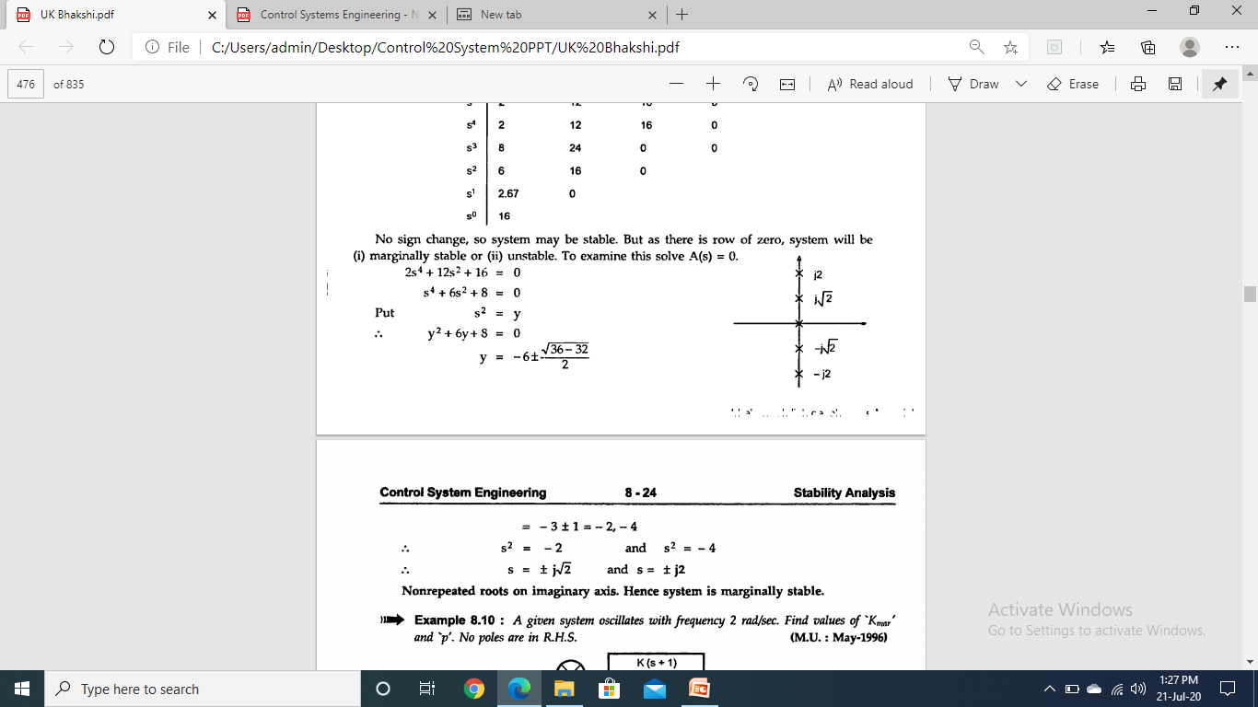

Slide 36
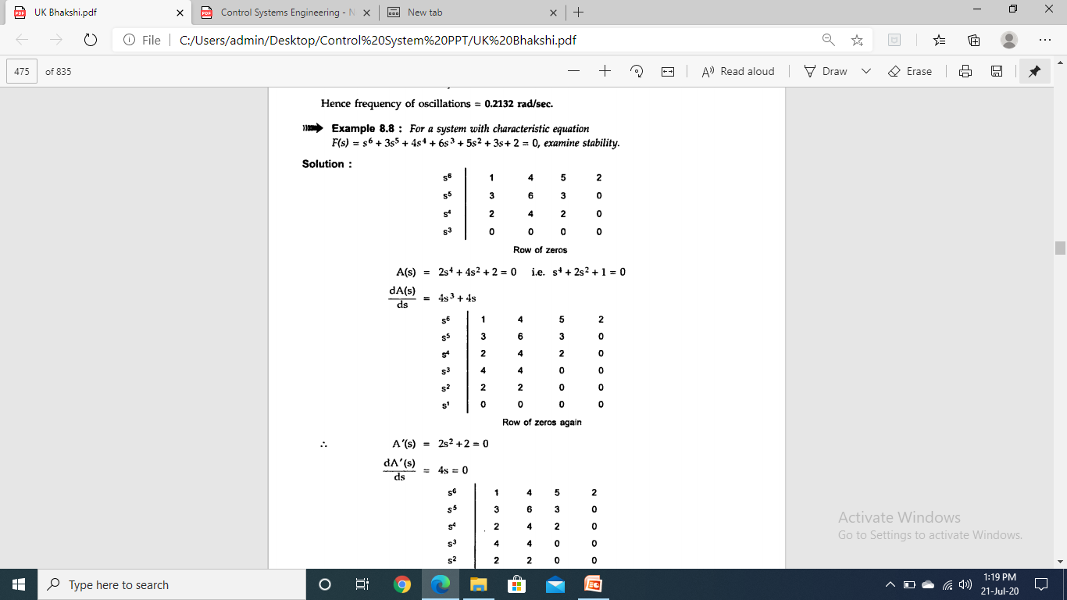
Example 9:- Determine the number of right-half-plane poles in the closed-loop transfer function

Slide 37
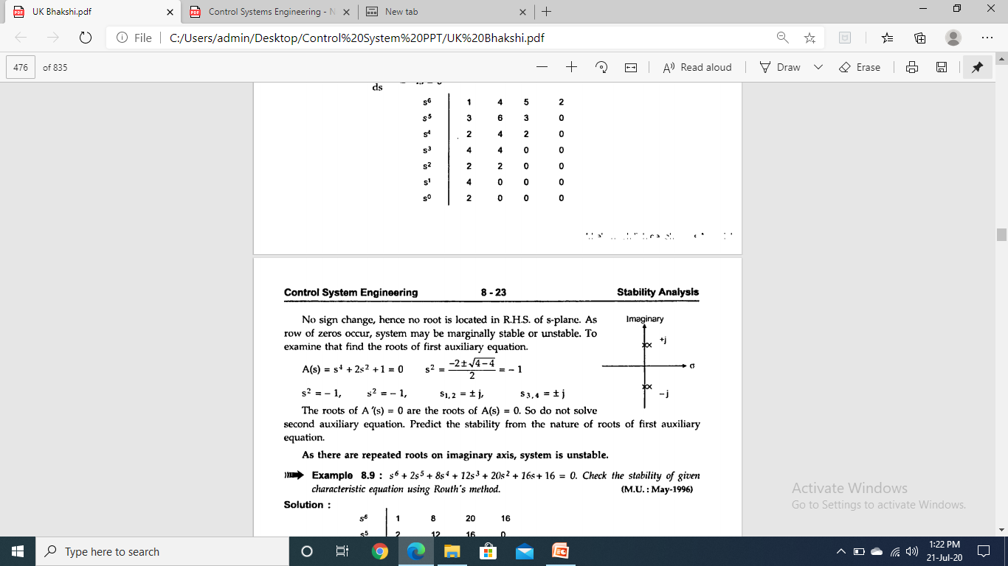

Slide 38
REFERENCES
Effect of Feedback and Stability (U.K Bhakshi & S.C Goyal “Feedback Control System” Technical Publication, Pune).
Numerical of Stability (Norman S. Nise “Control System Engineering” Wiley Eastern).

Slide 39
Thank You

